Slide 1


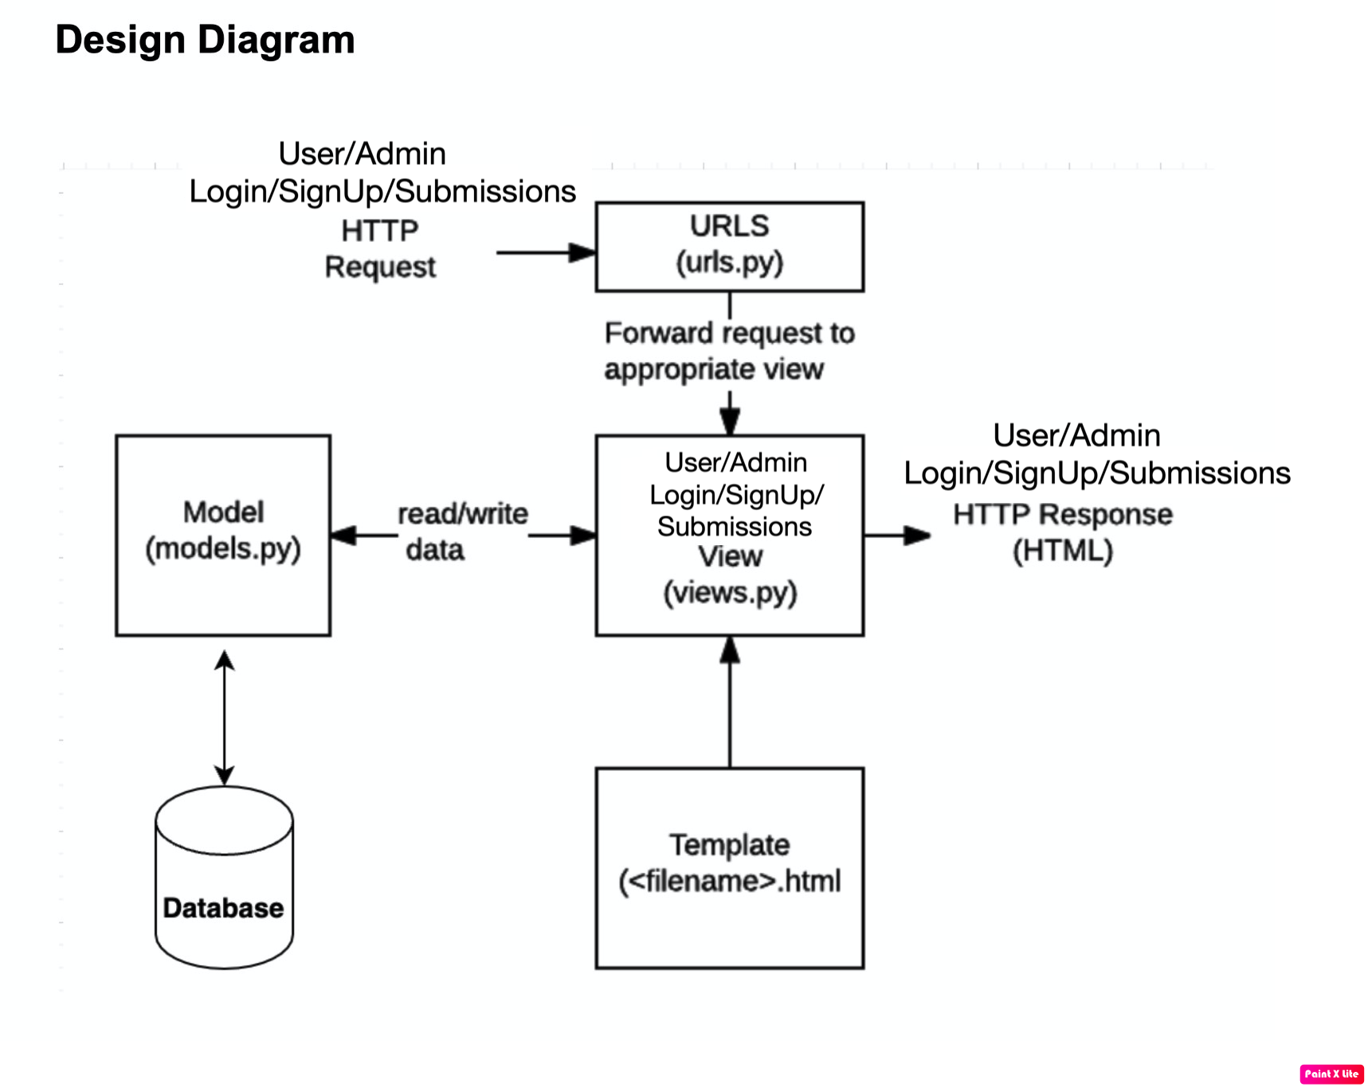
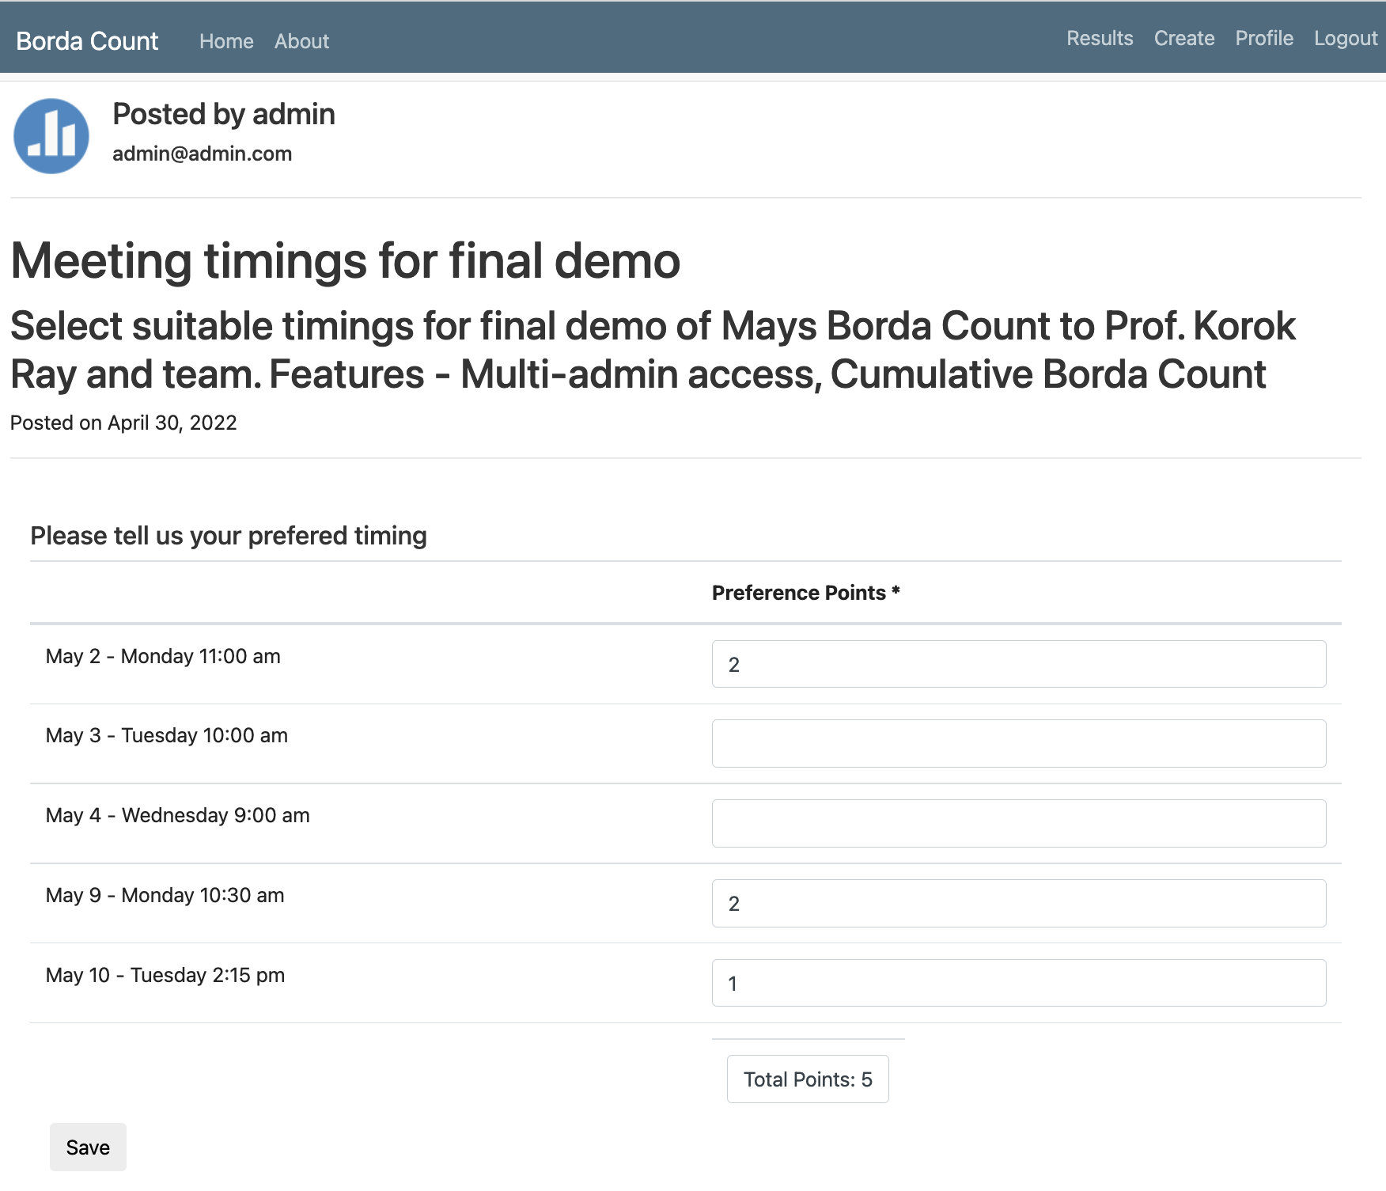
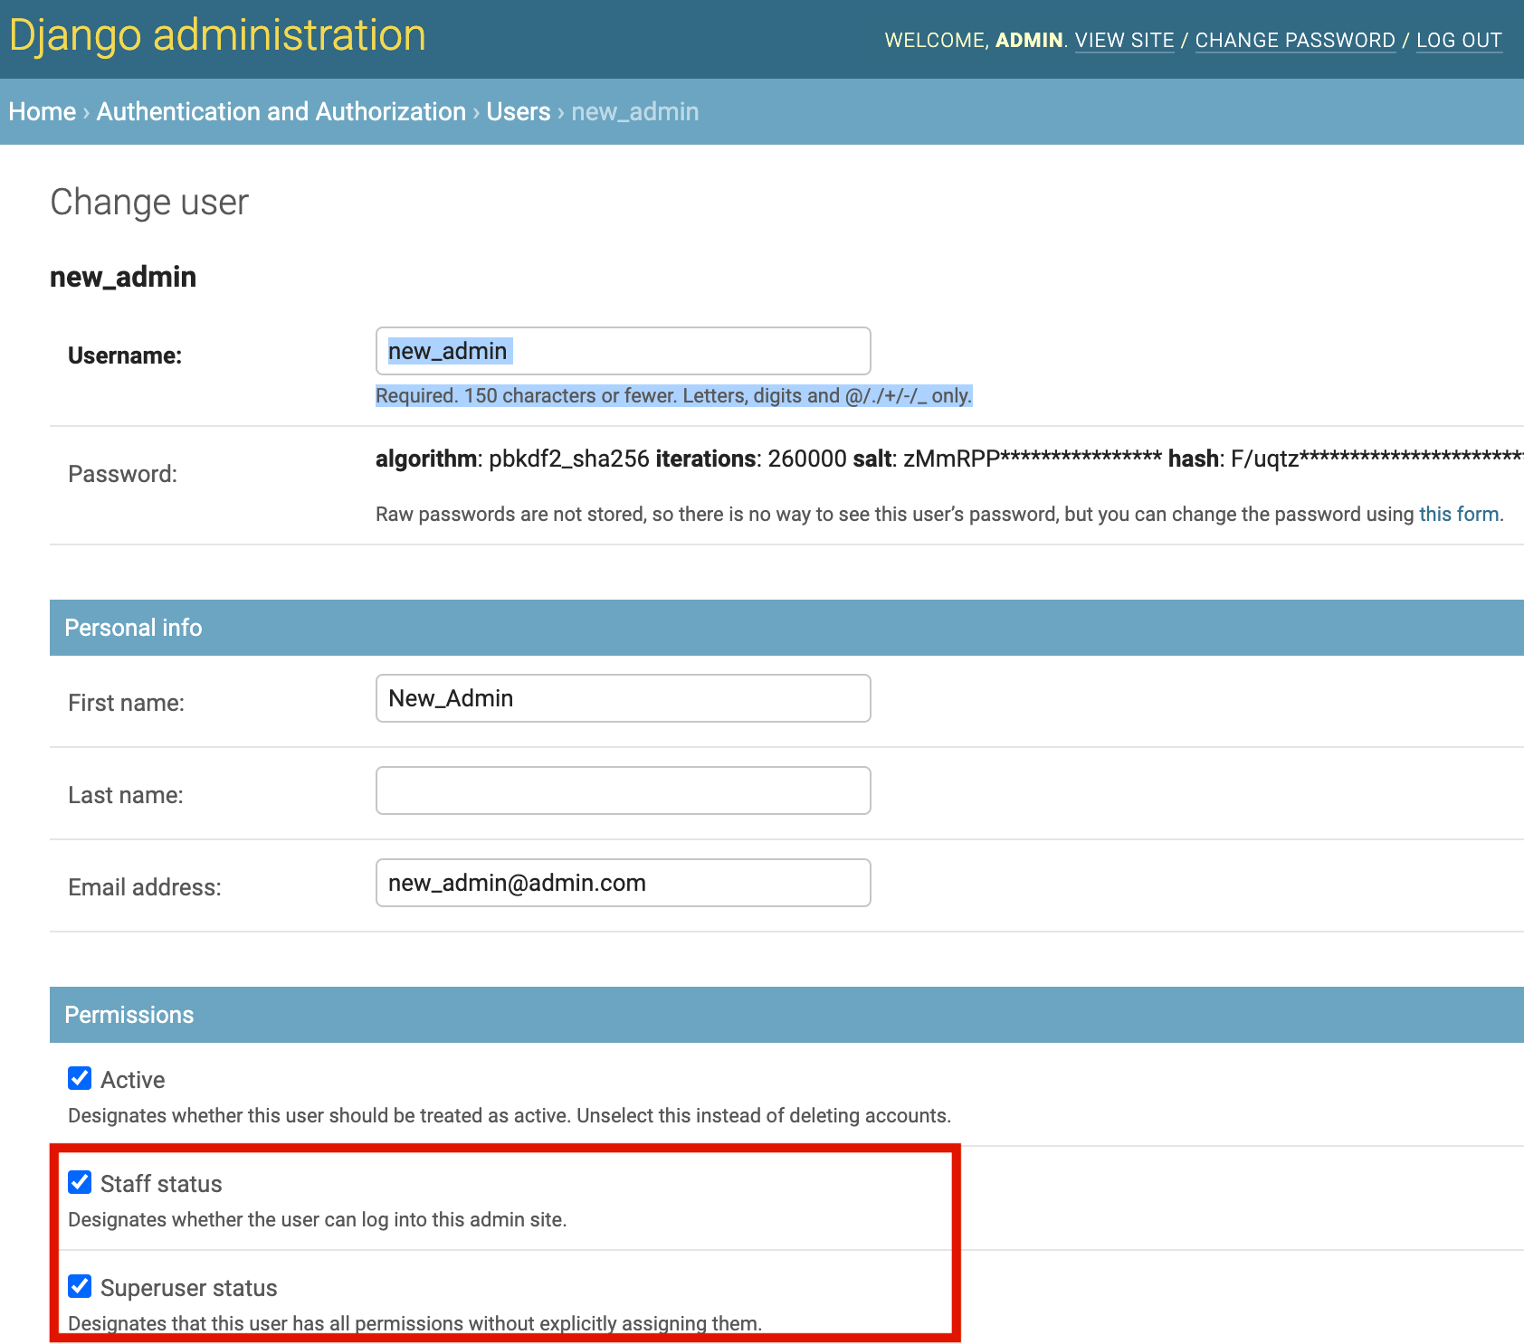
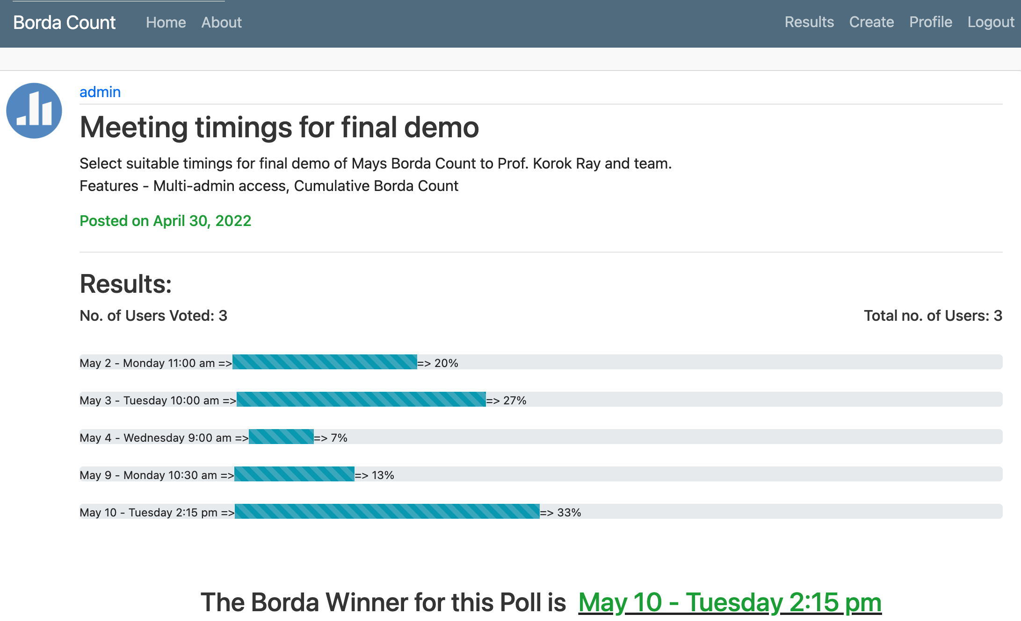
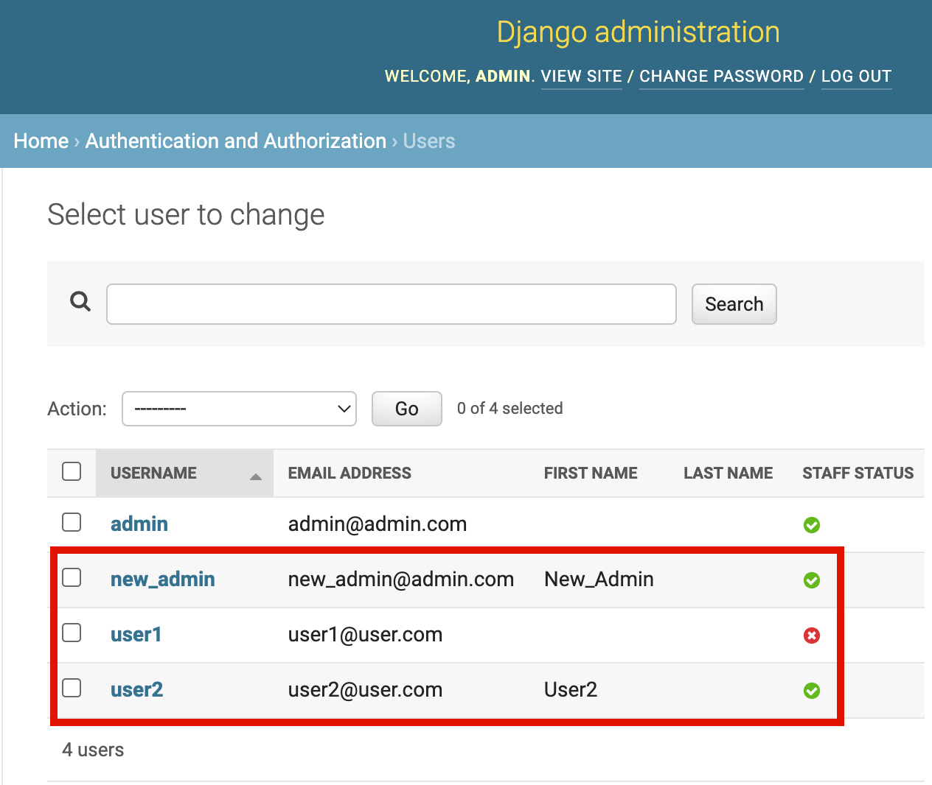
MAYS BORDA COUNT
Sneha Singh, Sunanda Saha, Shaista Ambreen, Upasna Mishra
Department of Computer Science and Engineering
INTRODUCTION
Customer: Prof. Korok Ray, Mays Business School.
Goal: Facilitate easy, seamless scheduling and RSVP systems for large groups.
Distinguished Features Implemented:
Multi Admin Access
Cumulative Borda Count
About the project: ‘Mays Borda Count’ is a Django web application using python and deployed on Heroku with agile development.
Design Diagram
CUMULATIVE BORDA COUNT
Users rate their preferences.
Admin accesses the results of the poll.
MULTI-ADMIN ACCESS
Admin updates the staff status of existing user or newly created admin
Users and their staff statuses:
RETROSPECTIVE
What Went Well:
Customer Interaction
Team Collaboration
Pair Programming
Iterative Development
Challenges:
Django Model Changes Deployment.
SurveyJs updates
Missing static files

